Slide 1

Use cases

Slide 2
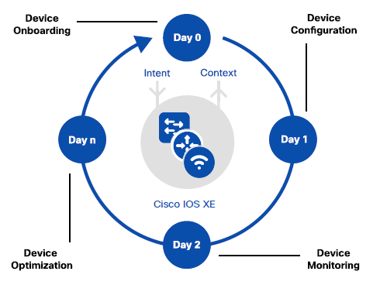

Slide 3
4 Leves
Level 1
Script
Level 2
Orchestration
Level 3
Multi vendor
Level 4
Client Access
ML, AI

Slide 4
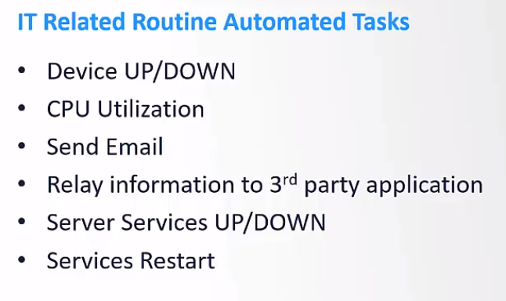
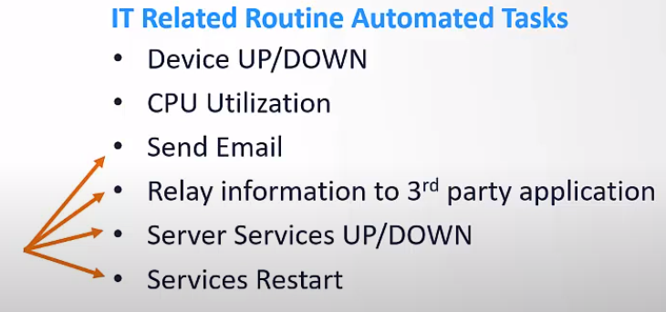
Automation vs Orchestration

Slide 5
SecureCRT script
https://github.com/LetMeGoogleIt4You/ARCH

Slide 6
Compare

Slide 7
Self made program
EEM failover
EEM script for restore config
GenConfig
IOS-XE Post ConfigDiff
https://developer.cisco.com/network-automation/detail/7dc20931-618e-11eb-bf3b-8af62562141a/

Slide 8
Controllers
Cisco
Aruba
Junpier
Mist

Slide 9
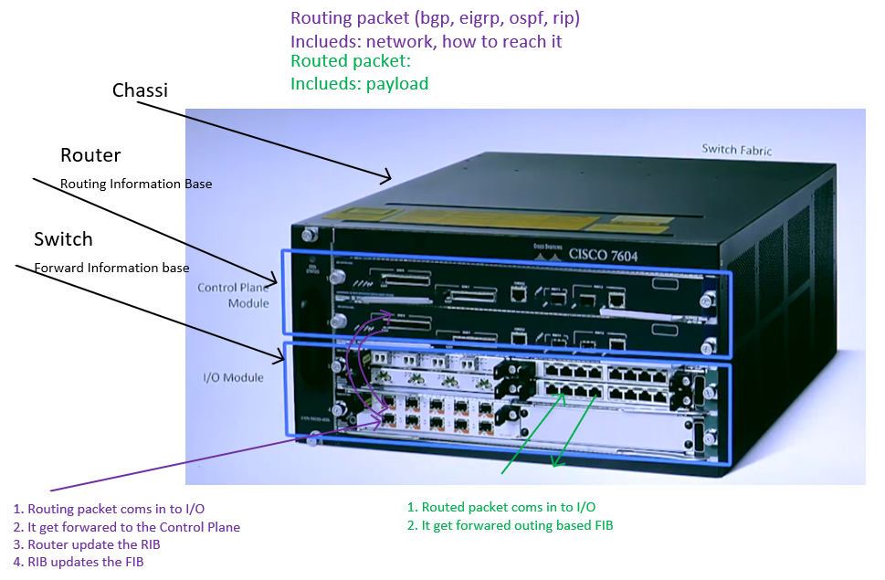

Slide 10
Pay to win
Anuta’s ATOM
https://www.anutanetworks.com/
Gluware
https://gluware.com/
https://atea-my.sharepoint.com/:f:/g/personal/magnus_haugen_atea_no/EpME0skX-UdEmNknf00aM30BY76AmuN_NwJTkPcelBYNtA?e=HmO38e
Unimus
https://unimus.net/

